Slide 1
LABORATORY
2

Slide 2
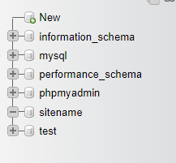
CREATE AND SELECT NEW DATABASE

Slide 3

CREATE THE USERS TABLE

Slide 4
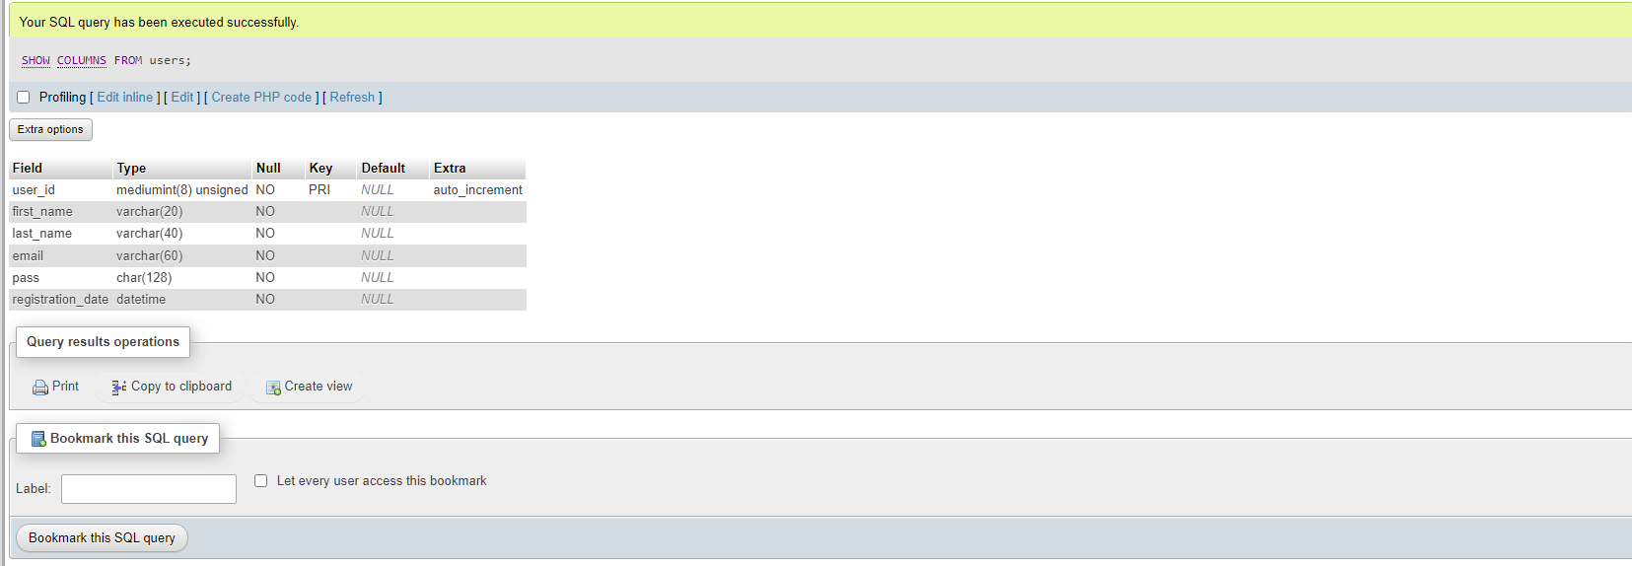
CONFIRM THE EXISTENCE OF THE TABLE

Slide 5

INSERT DATA INTO TABLE

Slide 6
SELECTING
DATA

Slide 7


Slide 8


Slide 9
USING
CONDITIONALS

Slide 10
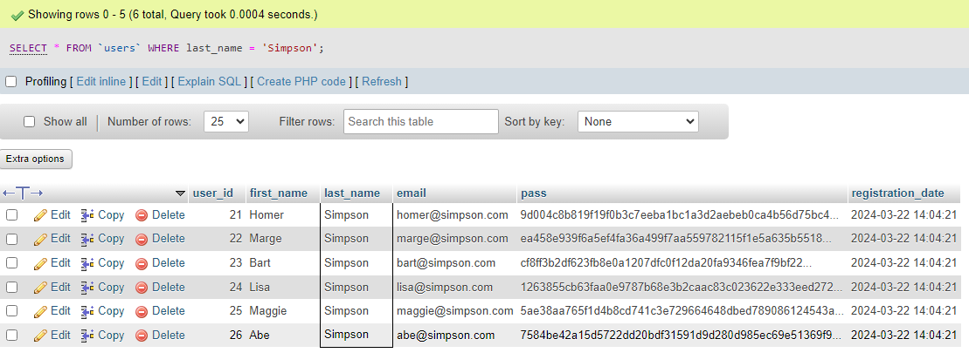

Slide 11
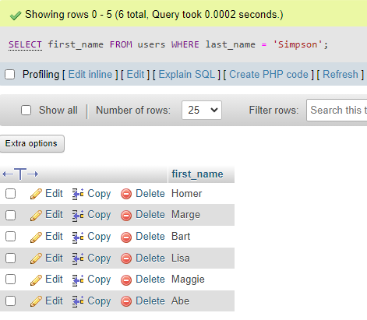

Slide 12
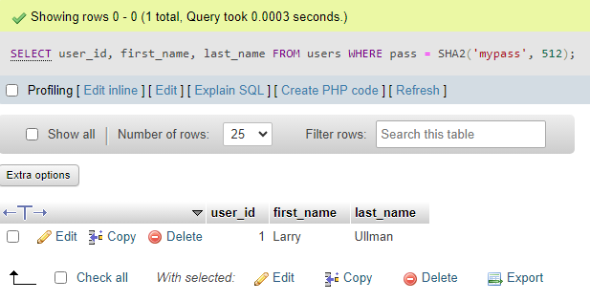

Slide 13
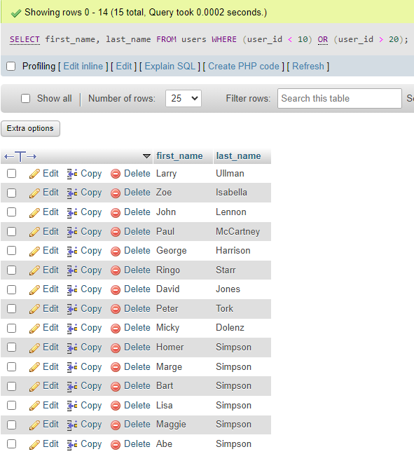

Slide 14
USING LIKE AND
NOT LIKE

Slide 15


Slide 16
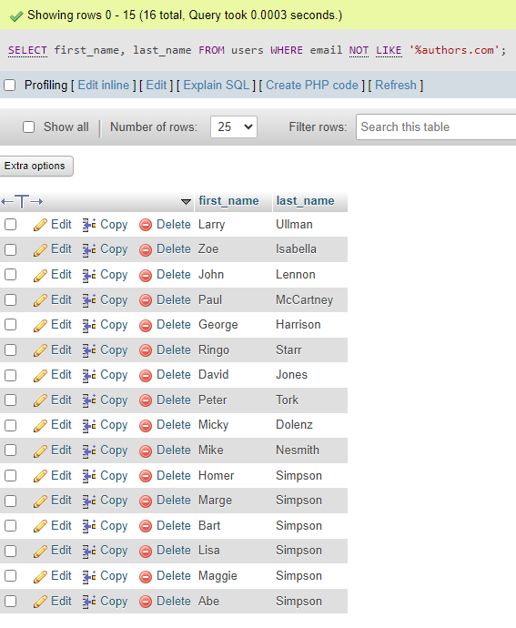

Slide 17
SORTING QUERY RESULTS

Slide 18
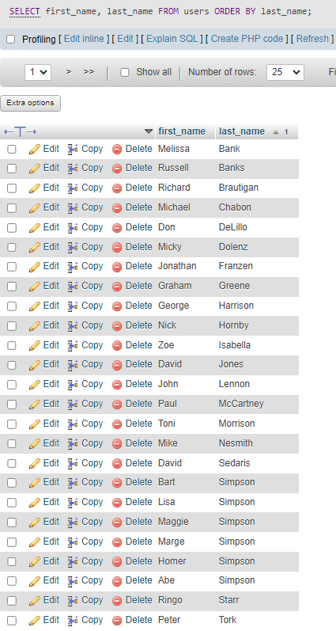

Slide 19
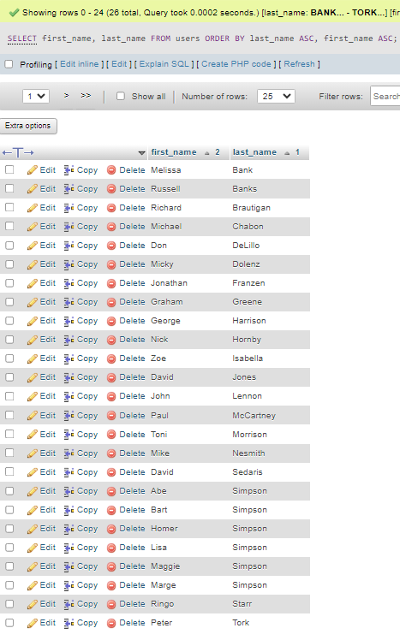

Slide 20
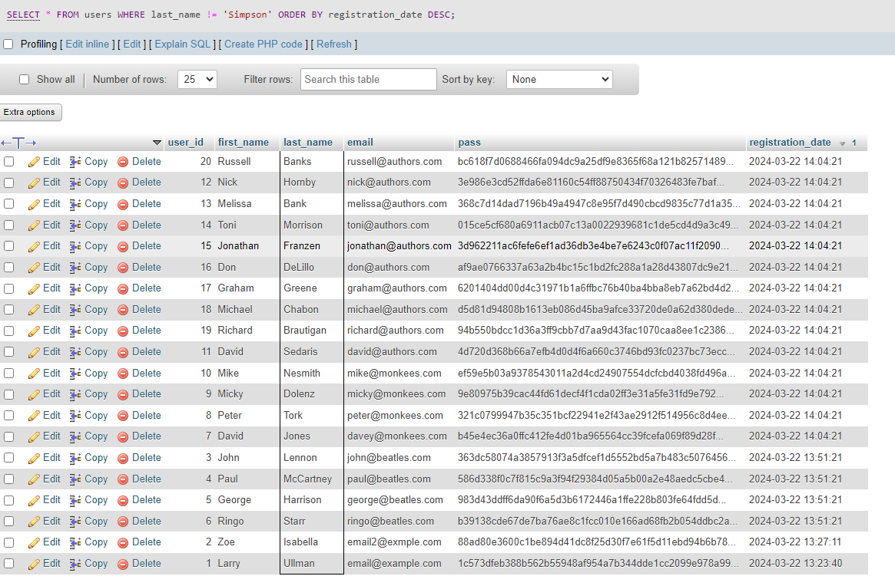

Slide 21
LIMITING QUERY RESULTS

Slide 22
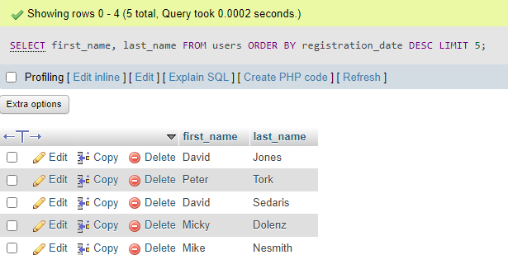

Slide 23


Slide 24
UPDATING DATA

Slide 25
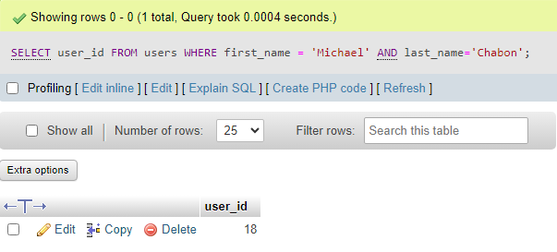

Slide 26


Slide 27


Slide 28
DELETING DATA

Slide 29
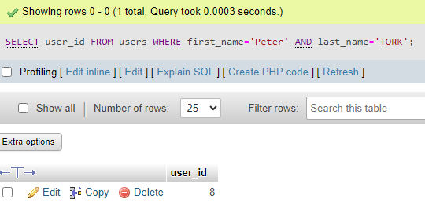

Slide 30


Slide 31


Slide 32


Slide 33
USING FUNCTIONS

Slide 34
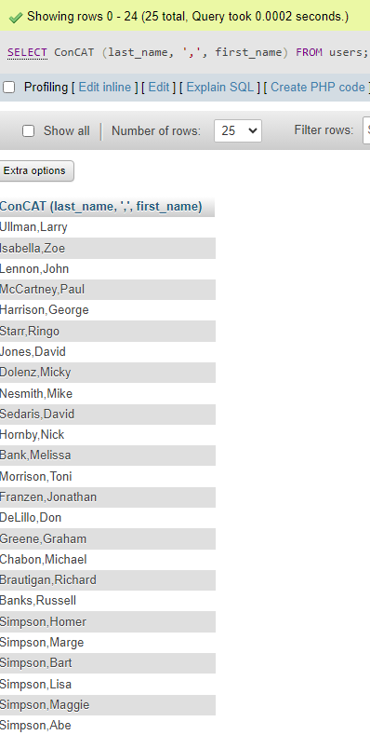

Slide 35
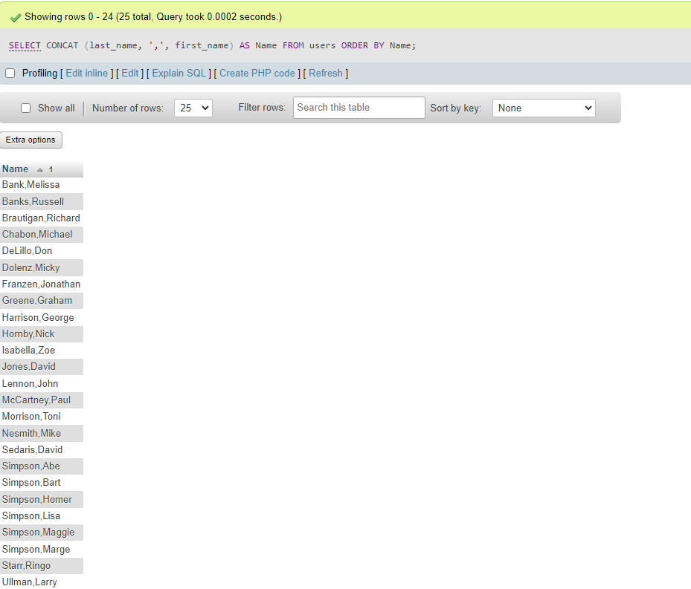

Slide 36
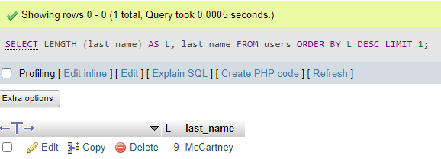

Slide 37
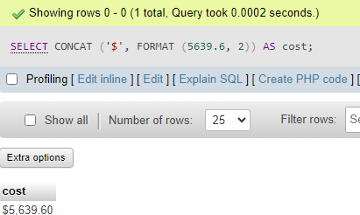

Slide 38
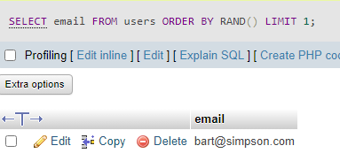

Slide 39


Slide 40


Slide 41
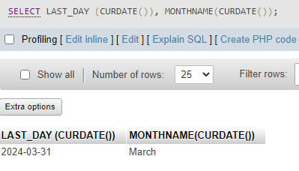

Slide 42
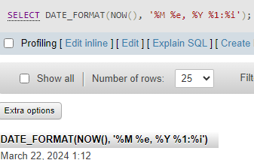

Slide 43


